Slide 1
Chapter 1: Introduction to Security

Slide 2
Learning Objectives
01
Explain the challenges of securing information
02
Define information security and explain why it is important
03
Identify the types of threat actors that are common today
04
Describe how to defend against attacks

Slide 3

Introduction
One area that has also been an especially frequent target of attacks is information technology (IT).
A seemingly endless array of attacks is directed at individuals, schools, businesses, and governments through desktop computers, laptops, and smartphones. Internet web servers must resist thousands of attacks every day.
Identity theft using stolen electronic data has skyrocketed.
An unprotected computer connected to the Internet may be infected in fewer than 60 seconds. Viruses, phishing, worms, and botnets, virtually unheard of just a few years ago, are now part of our everyday technology vocabulary.
The need to defend against these attacks directed toward our technology devices has created an element of IT that is now at the very core of the industry Known as information security, it is focused on protecting the electronic information of enterprises and users.

Slide 4
Categories of Information Security Personnel
Managerial personnel
Technical Personnel
Administer and manage plans, policies, and
People.
Designing,
configuring, installing, and maintaining technical security equipment.
Security Positions
Security Manager
Security Administrator
Security Technician
Chief Information Security Officer (CISO)
This person is responsible for assessing, managing,
and implementing security.
The security manager reports to the CISO and supervises
technicians, administrators, and security staff.
A security administrator manages daily operations of
security technology, and may analyze and design security solutions within a
specific entity as well as identifying users’ needs.
Technicians provide technical support
to configure security hardware, implement security software, and diagnose and
troubleshoot problems.

Slide 5
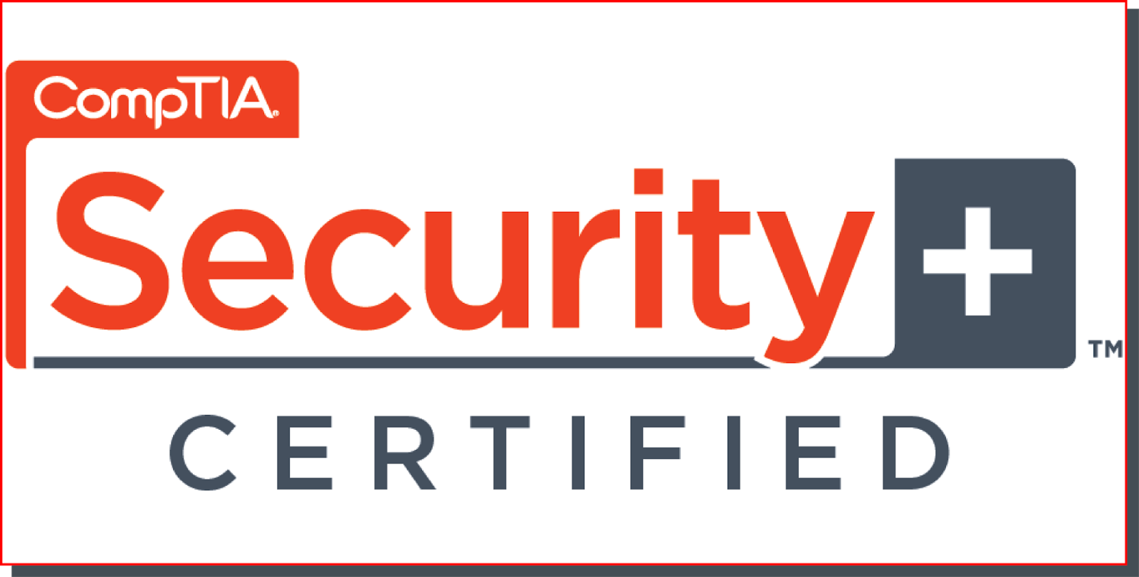
CompTIA Certification
Employment trends indicate that security personnel who also have a certification in security are in high demand. IT employers want and pay a premium for certified security personnel.
An overwhelming majority of enterprises use the Computing Technology Industry Association (CompTIA) Security+ certification to verify security competency.
Of the hundreds of security certifications currently available, Security+ is one of the most widely acclaimed.
Because it is internationally recognized as validating a foundation level of security skills and knowledge, the Security+ certification has become the security baseline for today’s IT professionals.
This Photo by Unknown Author is licensed under CC BY-SA-NC

Slide 6
Challenges of Securing Information
01

Slide 7
Today’s Security Attacks
Even though information security continues to rank as the number one concern of IT managers and tens of billions of dollars are spent annually on computer security, the number of successful attacks continues to increase.
Consider the following examples of recent attacks:
EXAMPLE NO.1
In order to demonstrate how easy it is to remotely control a car.
The researchers remotely disabled the brakes so that the Jeep finally ended up in a ditch.
The security researchers had taken advantage of the car’s Internet-connection feature that controls its entertainment and navigation systems, enables phone calls, and can be used to create a Wi-Fi hot spot.
Due to a vulnerability, anyone could gain access remotely to the car’s control systems from virtually anywhere.

Slide 8
Today’s Security Attacks
EXAMPLE NO.2
A security researcher was on a United Airlines flight and tweeted that he was testing the plane’s systems. United’s cybersecurity team saw the tweet and informed the FBI. When agents checked his seat, they found that he had tampered with the Seat Electronic Box (SEB) and connected his laptop to the in-flight entertainment system. This gave him access to other airplane systems. He even claimed he could change the plane’s altitude by modifying its software. As a result, United Airlines banned him from flying with them again.

Slide 9
Today’s Security Attacks
EXAMPLE NO.3
Yahoo revealed that hackers had stolen data from 500 million accounts by breaking into its servers. The stolen information included names, emails, phone numbers, birth dates, security question answers, and passwords. The breach had actually happened two years earlier, but Yahoo only found out recently.
Two months later, Yahoo announced another, even bigger breach—this time affecting 1 billion accounts. This attack had happened three years earlier but was only discovered after law enforcement and security experts investigated.
Experts believe the stolen data was being sold on the dark web for years, likely used in other cyberattacks. In response, Yahoo stated that it was improving security to prevent future breaches.

Slide 10
Today’s Security Attacks
EXAMPLE NO.4
Hackers sometimes leave infected USB drives in public places, hoping that someone will plug them into their computer out of curiosity. This can install malware and compromise the system.
An even more dangerous device, called the USB Killer, looks like a normal flash drive but is designed to destroy computers. When plugged in, it draws power from the computer, stores it in capacitors, and then releases it in a sudden burst, frying the motherboard. If the computer survives the first shock, the USB Killer keeps repeating the process until the system is completely destroyed.

Slide 11
Today’s Security Attacks
EXAMPLE NO.5
Hackers stole data from the European Space Agency (ESA) and leaked information from 8,107 users online. Even though ESA needed to keep its space exploration data secure, many of its scientists used very weak passwords.
Shockingly, 39% of the passwords (3,191 in total) were only three characters long, like "410" or "808." Only 22 users followed best practices by using strong passwords with at least 20 characters. This weak security made it easier for attackers to access ESA's data.

Slide 12
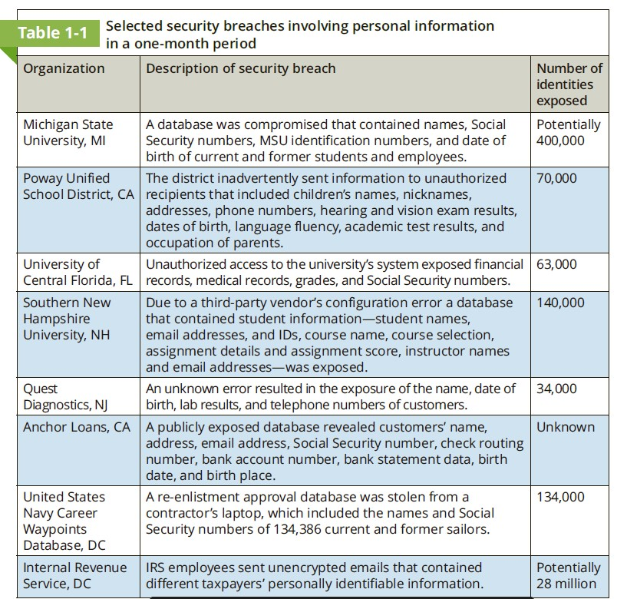
Security Breaches
Content Here

Slide 13
.
Reasons for Successful Attacks
Widespread vulnerabilities
Hardware Limitation
Some devices have limited resources (CPU, memory, storage).
Attackers can overload these resources, causing system failure.
Many hardware and software systems have security weaknesses.
Hackers can pick and exploit any of these flaws.
Issues include lack of vendor support, outdated systems, and missing updates
Enterprise issues
Configuration Issues
Security features may not be properly set up.
Common problems include default settings, weak configurations, and misconfigurations.
Attacks often succeed due to weak business processes, not just technical flaws.
Business Process Compromise (BPC) happens when attackers exploit everyday operations to their advantage.
Poorly Designed Software
Software flaws make it easier for hackers to break in.
Examples include weak architecture, improper input handling, and poor error handling

Slide 14
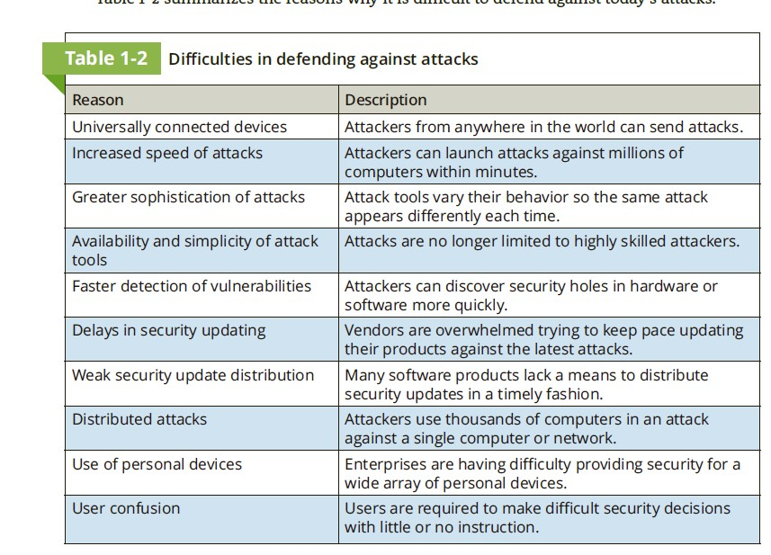
Difficulties in Defending Against Attacks
Content Here

Slide 15
02
Information Security

Slide 16
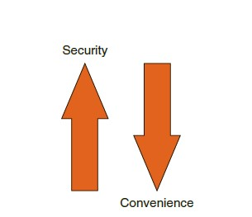
Understanding Security
What is security? The word comes from the Latin, meaning free from care.
Sometimes security is defined as the state of being free from danger, which is the goal of security.
It is also defined as the measures taken to ensure safety, which is the process of security.
Since complete security can never be fully achieved, the focus of security is more often on the process instead of the goal. In this light, security can be defined as the necessary steps to protect from harm.
It is important to understand the relationship between security and convenience. As security is increased, convenience is often decreased.
That is, the more secure something is, the less convenient it may become to use (security is said to be inversely proportional to convenience).

Slide 17
Defining Information Security
Several terms are used when describing security in an IT environment: computer security, IT security, cybersecurity, and information assurance, to name just a few.
Whereas each has its share of proponents and slight variations of meanings, the term information security may be the most appropriate because it is the broadest: protecting information from harm.
Information security is often used to describe the tasks of securing information that is in a digital format, whether it be manipulated by a microprocessor (such as on a personal computer), preserved on a storage device (like a hard drive or USB flash drive), or transmitted over a network (such as a local area network or the Internet).
Information security cannot completely prevent successful attacks or guarantee that a system is totally secure,
The goal of information security is to ensure that protective measures are properly implemented to ward off attacks and prevent the total collapse of the system when a successful attack does occur.
Thus, information security is first protection.

Slide 18
Defining Information Security
Second, information security is intended to protect information that provides value to people and enterprises.
There are three protections that must be extended over information: confidentiality, integrity, and availability
Confidentiality
Integrity
Availability
Availability ensures that data is accessible to authorized users. This means that the information cannot be “locked up” so tight that no one can access it. It also means that attackers have not performed an attack so that the data cannot be reached. In this example the total number of items ordered as the result of an online purchase must be made available to an employee in a warehouse so that the correct items can be shipped to the customer.
Confidentiality ensure that only authorized parties can view the information. Providing confidentiality can involve several different security tools, ranging from software to scramble the credit card number stored on the web server to door locks to prevent access to those servers.
Integrity ensures that the information is correct and no unauthorized person or malicious software has altered the data. In the example of the online purchase, an attacker who could change the amount of a purchase from $10,000.00 to $1.00 would violate the integrity of the information.

Slide 19
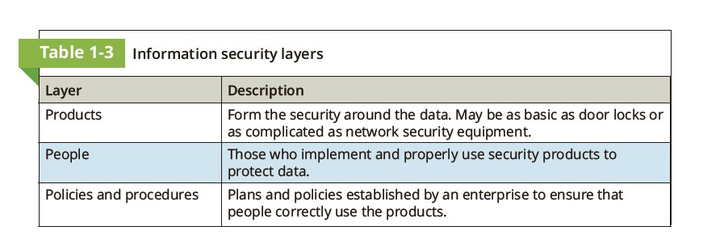
Defining Information Security
The third objective of information security is to protect the integrity, confidentiality, and availability of information on the devices that store, manipulate, and transmit the information.
This protection is achieved through a process that is a combination of three entities. Product, people and procedure .
Thus, information security may be defined as that which protects the integrity, confidentiality, and availability of information through products, people, and procedures on the devices that store, manipulate, and transmit the information.

Slide 20
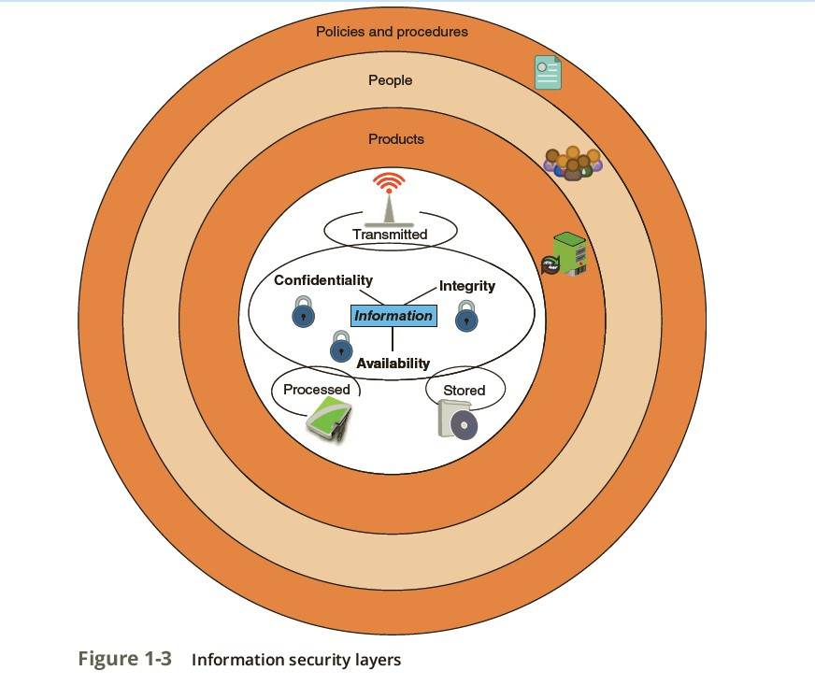

Slide 21
Information Security Terminology
The following scenario helps to illustrate information security terms and how they are used.
Suppose that Ellie wants to purchase a new motorized Italian scooter to ride from her apartment to school and work.
However, because several scooters have been stolen near her apartment she is concerned about its protection.
Although she parks the scooter in the gated parking lot in front of her apartment, a hole in the fence surrounding the apartment complex makes it possible for someone to access the parking lot without restriction.

Slide 22
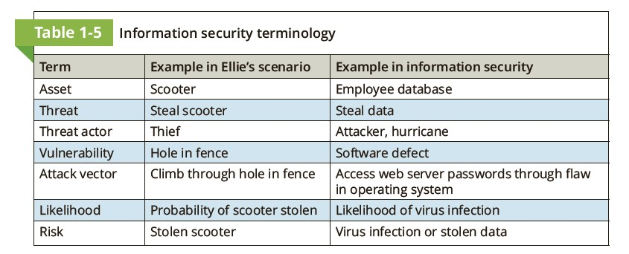
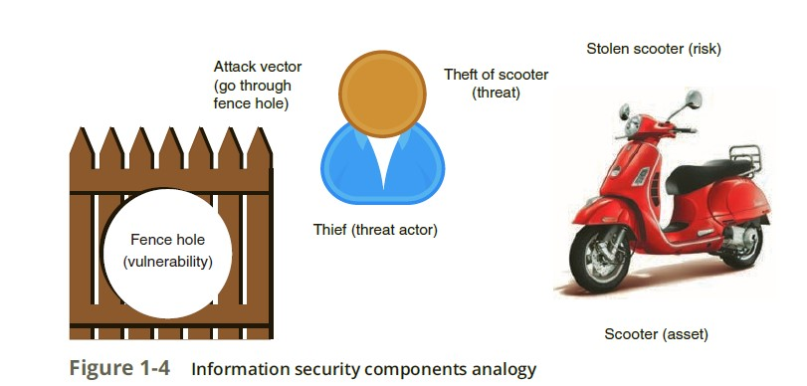

Slide 23
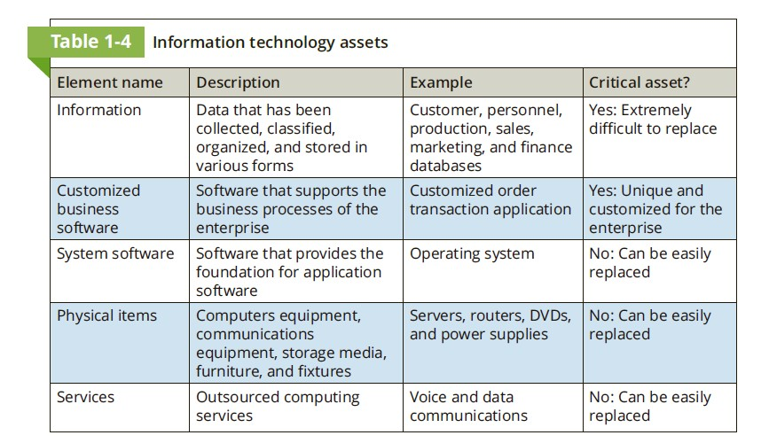

Slide 24
Understanding the Importance of Information Security
Information security is important to enterprises as well as to individuals. That is because information security can be helpful in
Preventing data theft (preventing data from being stolen is often cited by enterprises as a primary objective of their information security.)
Thwarting identity theft (Identity theft involves stealing another person’s personal information)
Avoiding the legal consequences of not securing information (federal and state laws have been enacted to protect the privacy of electronic data.)
Maintaining productivity (Cleaning up after an attack diverts time, money, and other resources away from normal activities.)

Slide 25
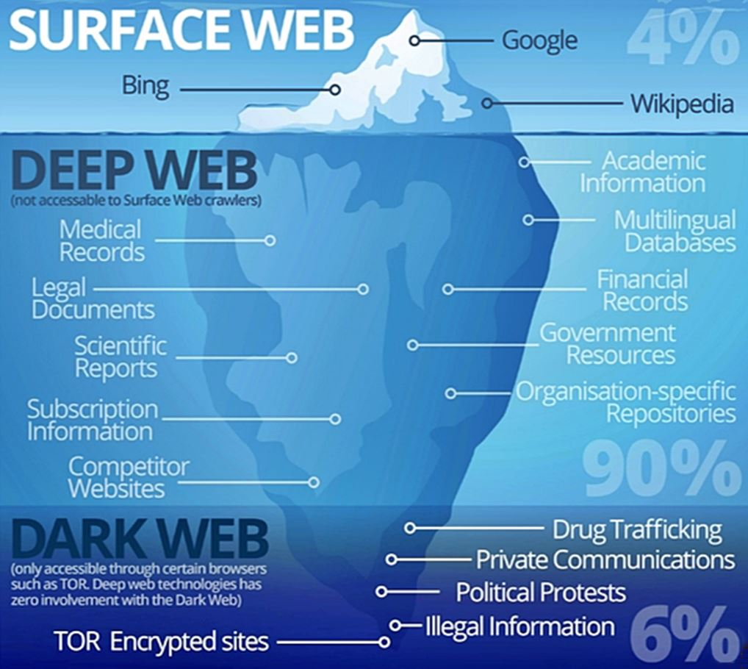

Slide 26
Types and Attributes of Threat Actors
03

Slide 27
Threat Actors
Threat actor is a generic term used to describe individuals who launch attacks against other users and their computers (another generic word is simply attackers).
The attributes, or characteristic features, of the different groups of threat actors can vary widely.
Some groups are very sophisticated (have developed a high degree of complexity) and have created a massive network of resources. while others are simply individuals just seeing what they can do.
In addition, some groups have deep funding and resources while others have none.
And whereas some groups of threat actors may work within the enterprise (internal) others are strictly external.
Finally, the intent and motivation the reason “why” behind the attacks of the threat actors vary widely.
In the past, the term hacker referred to a person who used advanced computer skills to attack computers, and variations of that term were also introduced (black hat hackers, white hat hackers, gray hat hackers).
However, that term did not accurately reflect the different motives and goals of the attackers.

Slide 28
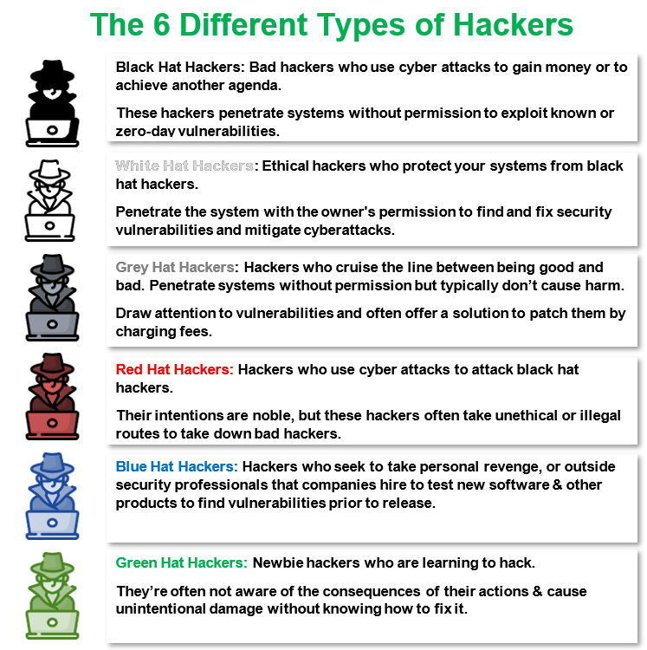

Slide 29
Types of Cyber Threat Actors
Script Kiddies
These are amateur hackers with little technical knowledge.
They rely on free attack tools from the internet to launch attacks.
Hacktivists
These hackers are driven by beliefs or ideology.
They often deface websites to make political or social statements.
Nation-State Actors
Governments use these hackers to attack other countries or even their own citizens.
Their goal is often financial damage, espionage, or reputation harm.
Insiders
These are employees, contractors, or business partners who misuse their access.
They may steal data, commit fraud, or sabotage systems due to personal grudges, bribery, or blackmail.

Slide 30
Threat Actors
Today threat actors are recognized in more distinct categories, such as script kiddies, hactivists, nation state actors, insiders, and others.
Script Kiddies: Script kiddies are individuals who want to attack computers yet they lack the knowledge of computers and networks needed to do so. Script kiddies instead do their work by downloading freely available automated attack software (called open-source intelligence or scripts) from websites and using it to perform malicious acts.
Hactivists: A group that is strongly motivated by ideology (for the sake of their principles or beliefs) is hactivists.
Hactivists (a combination of the words hack and activism) are generally not considered to be a well-defined and well-organized group of threat agents.
Attacks by hactivists can involve breaking into a website and changing the contents on the site as a means of making a political statement.
Nation State Actors: Instead of using an army to march across the battlefield to strike an adversary, governments are increasingly employing their own using state-sponsored attackers for launching computer attacks against their foes. These are known as nation state actors.
Their foes may be foreign governments or even citizens of its own nation that the government considers hostile or threatening.
A growing number of attacks from nation states actors are directed toward businesses in foreign countries with the goal of causing financial harm or damage to the enterprise’s reputation.

Slide 31
Threat Actors
Today threat actors are recognized in more distinct categories, such as script kiddies, hactivists, nation state actors, insiders, and others.
Insiders: Another serious threat to an enterprise comes from its own employees, contractors, and business partners, called insiders.
For example, a healthcare worker disgruntled about being passed over for a promotion might illegally gather health records on celebrities and sell them to the media, or a securities trader who loses billions of dollars on bad stock bets could use her knowledge of the bank’s computer security system to conceal the losses through fake transactions.
Although some insider attacks consist of sabotage (from employees who have been formally reprimanded or demoted) or the result of bribery or blackmail, most insider attackers involve the theft of data.

Slide 32
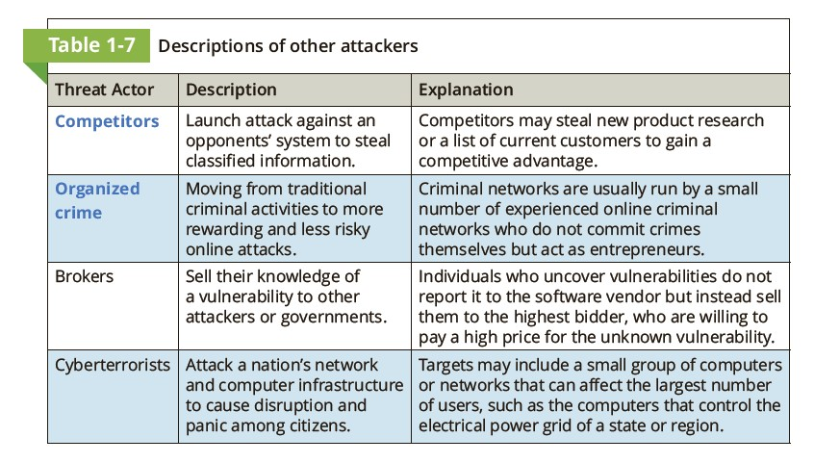
Other Threat Actors

Slide 33
04
Defend against Attacks

Slide 34
Defending against Attacks
Fundamental Security Principles: Although multiple defenses may be necessary to withstand an attack, these defenses should be based on five fundamental security principles:
Layering (layered approach has the advantage of creating a barrier of multiple defenses that can be coordinated to thwart a variety of attacks.)
Limiting (Limiting access to information reduces the threat against it. This means that only those personnel who must use the data should have access to it.)
Diversity (Diversity is closely related to layering. Just as it is important to protect data with layers of security, the layers also must be different (diverse). This means that if attackers penetrate one layer, they cannot use the same techniques to break through all other layers.)
Obscurity (obscurity in information security would be not revealing the type of computer, version of operating system, or brand of software that is used)
Simplicity (Complex security systems can be hard to understand, troubleshoot, and even feel secure about. As much as possible, a secure system should be simple for those on the inside to understand and use. In short, keeping a system simple from the inside, but complex on the outside).
These principles provide a foundation for building a secure system.

Slide 35
THANK YOU

